Slide 1
Project #5
Passenger and
Driver Safety
Group: Miguel, Colin, Fabian, Justin, Levi

Slide 2
Project Roles
Miguel Millan – Project Lead / Documentation / Algorithm Training
Justin Isrow – Data Collection / Algorithm Training / Web Application
Colin Campbell – Documentation / Algorithm Training
Fabian LeFevre – Data Collection / Documentation / Web Application
Levi Orlando - Documentation / Web Application / Data Collection

Slide 3
Project Plan
Sprint 1: 1/7/2019 - 1/16/2019
Project Plan
Requirements
Tool Chain Setup
Project Scope Capture
Sprint 2: 1/16/2019 - 1/23/2019
Cloud hosted server setup and configuration.
Hardware Research and Acquisition.
Develop User Stories
Tensorflow and image classification
Notes:
Miguel Presents

Slide 4
Project Plan
Sprint 3: 1/23/2019 - 2/11/2019
Deploy hardware
Start data collection
Develop event classification procedure
Initial web UI for cloud server
Sprint 4: 2/11/2019- 2/25/2019
Label / identify events in data for training
Start manual training of the algorithm
Add monitoring statistics to Web UI
Notes:
Focus on change detection
Use simulated data - perhaps we’ll just be sitting in a room and start a fake fight, bring back in room and leave without, etc

Slide 5
Project Plan
Sprint 5: 2/25/2019 - 3/11/2019
Continue collecting data and refining the algorithm
Start testing the algorithm against a subset of labeled data
Web UI Improvements
Sprint 6: 3/11/2019 - 3/25/2019
Continue collecting data and refining the algorithm
Web UI Improvements
Start testing on unlabeled data and review post flagging
Notes:
Miguel Presents

Slide 6
Project Plan
Sprint 7: 3/25/2019 - 4/9/2019
Continued Testing and debugging
Dry Run - full autonomous detection
Sprint 8: 4/9/2019 - 4/24/2019
Continued Testing and debugging
Final Competition
Notes:
Miguel Presents

Slide 7
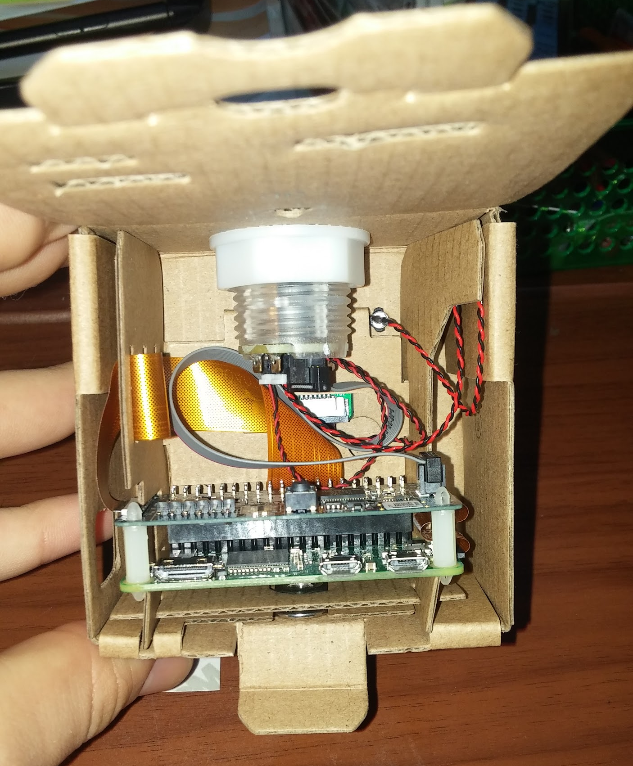
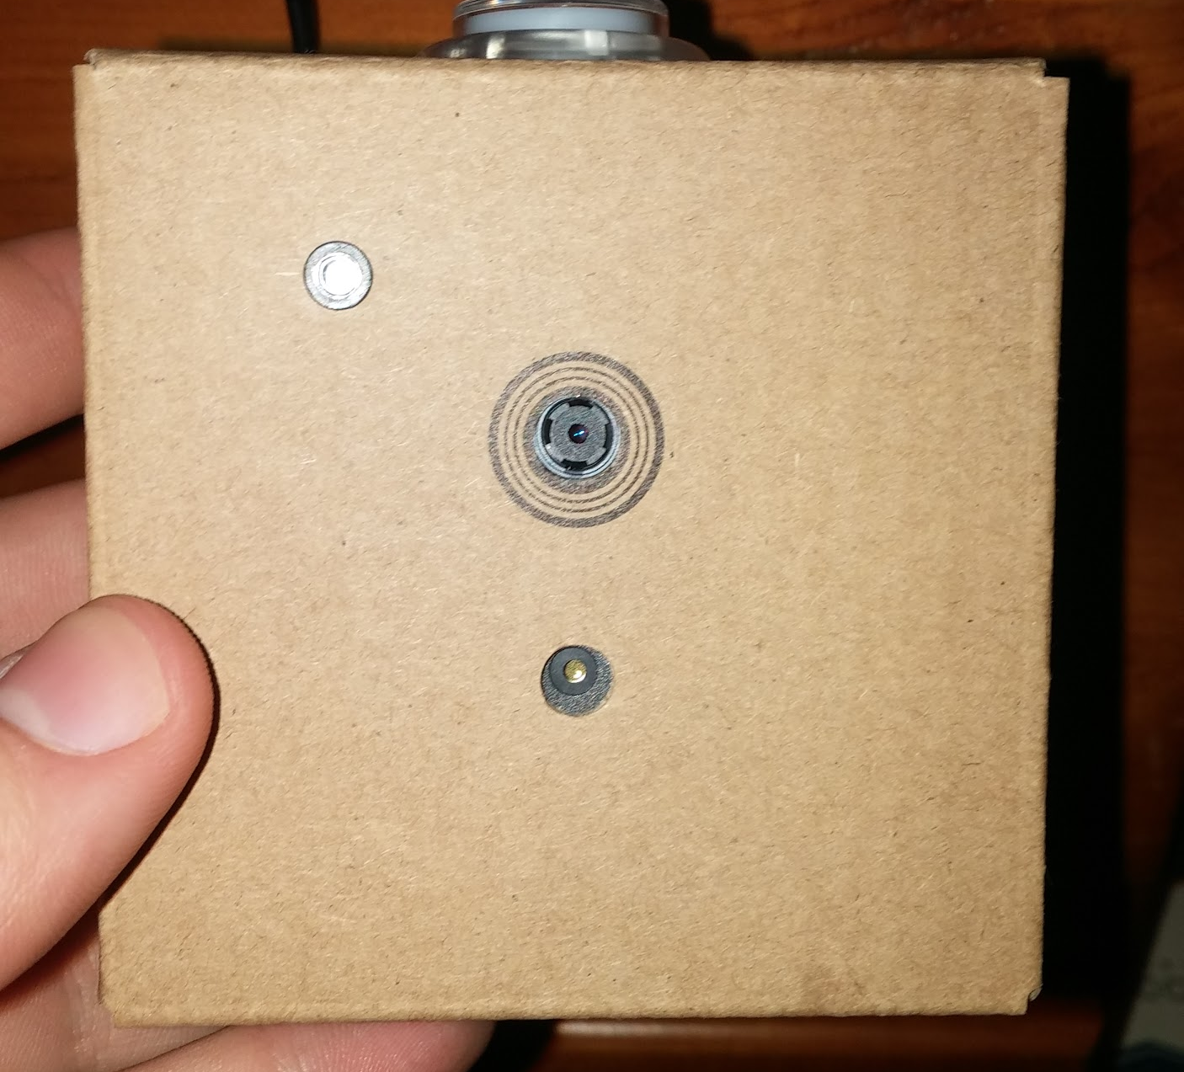
Hardware
AIY Vision Kit:
Pi-zero
VPU
Camera
LED
Button
Buzzer/speaker
Notes:
Left:
Front view of the vision kit
Led light in top left corner
Pi Camera in the center
Buzzer/speaker below the camera (can be programmed to beap)
Right:
Inside view from the back
The light up button is the topmost item
The pi zero is the bottom board, the VPU is attached to the pi zero.

Slide 8
Current Sprint User Stories
Next Sprint User Stories
As a web application, I can store user information.
As an administrator, I can log into the web application.
As a camera, I can stream live recordings to the web application.
As a camera, I can record events.
As a web application, I can store recorded events in the cloud database.
As a web application, I can store user information.
As an administrator, I can register bus camera systems.
As an administrator, I can register monitors of the bus camera systems.
As an administrator, I can log into the web application.
Notes:
Levi Presents

Slide 9
Next Sprint Objectives
Deploy local system
Configure the pi to stream data using WebRTC with UV4L
Need to figure out how/where to get data for different events.
Start Collecting data
Create model to detect commotion / agitated passengers.
Notes:
Colin presents

Slide 10
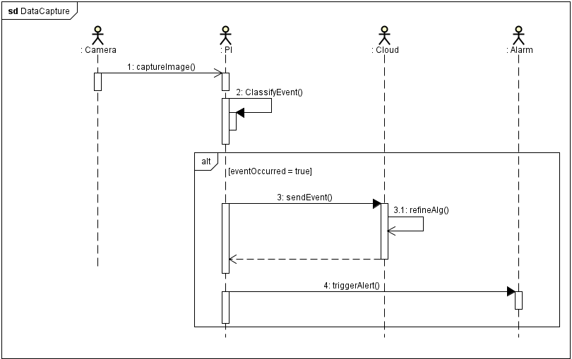
Sequence Diagram
Notes:
Miguel Presents

Slide 11
Risks & Challenges
Where to deploy the local system.
Collecting enough data to represent the possible events.
Overfitting data: the system is only good at recognizing training data; limited usefulness.
Notes:
Fabian Presents

Slide 12
Mitigation Plan
We can try asking the school if we can deploy the local system on a Bear Bus.
However, might not give desired events.
Initially, we might be able to supplement our lack of data with online video streams.
Notes:
Fabian Presents

Slide 13
Demo: Web Registration + Vision Kit
Notes:
Justin & Miguel Present - Website and Hardware (isrow.net)

